Slide 1

Offline Recognition Of Handwritten Text Using
Combination Of Neural Networks
TULASI MALINI V K 211719104154 VENKADA RAMANAN P 211719104156
UNDER THE GUIDANCE OF
Maheswari B
Assistant Professor
Department of CSE
Rajalakshmi Institute of Technology
01/03/23 Department of Computer Science and Engineering

Slide 2
ABSTRACT
Recognition of handwriting is a critical challenge in artificial intelligence having implications for numerous areas such as document analysis, optical character recognition, and natural language processing.
In this study, a novel deep neural network technique for offline handwritten textual data recognition is described.
Due to the volume of data available today and the numerous algorithmic improvements ongoing, it is now simpler to construct deep neural networks.
To achieve high accuracy in handwriting recognition tasks by incorporating a few deep learning approaches, including RCNN, CNN along with RNN and Long Short-Term Memory (LSTM) networks. CTC method is also frequently used to train deep learning models for sequence identification and loss estimation.

Slide 3
INTRODUTION
Handwriting recognition is now a crucial technique for many applications in the modern digital age.
With digitizing handwritten documents, automating manual data entry, and improving accessibility for individuals with impairments, handwriting recognition technology can be used.
Offline handwriting recognition refers to the ability of a computer to identify and interpret handwriting without the use of an internet connection. It has a wide range of applications in areas such as education, banking, healthcare, and many more.
Deep learning algorithms and neural networks are used in the sophisticated technology underpinning offline handwriting detection.

Slide 4
Related Works
Author | Year of Publication | Name of the Journal/ Publication | Abstract
DMYTRO ZHELEZNIAKOV, VIKTOR ZAYTSEV AND OLGA RADYVONENKO Faculty of Computer Science and Cybernetics, National University of Kyiv, 01601 Kyiv, Ukraine | 2021 | Online Handwritten Mathematical Expression Recognition and Applications: A Survey | Convolutional Neural Networks (CNN), Long Short-Term Memory (LSTM) and Bidirectional Long Short-Term Memory Networks(BLSTM)
Zuo Huahong, Tang Junyi, Han Ping School of Information Engineering Wuhan University of Technology | 2020 | A New Type Method of Adhesive Handwritten Digit Recognition Based on Improved Faster RCNN | Region Proposal Network(RPN),Faster RCNN, YOLO

Slide 5
Related Works
Author | Year of Publication | Name of the Journal/ Publication | Abstract
“J. Hussain, Vanlalruata” Department of Mathematics and Computer Science Mizoram University Aizawl, India | 2018 | A Hybrid Approach Handwritten Character Recognition for Mizo using Artificial Neural Network | BPNN (Back Propagation Neural Network), RBF (Radial Basis Function), RNN (Recurrent Neural Network and LVQ (Learning vector Quantization)
Keerthi Prasad G, Vinay Hegde , Asha K, Krishnappa H K Research Scholar VTU Dept. of ISE, GMIT Davanagere, INDIA | 2017 | Handwriting Recognition System for South Indian Languages – A Technical Review | Principal Component Analysis (PCA) and Dynamic Time Wrapping (DTW)

Slide 6
Related Works
Author | Year of Publication | Name of the Journal/ Publication | Abstract
S M Shamim, Mohammad Badrul Alam Miah, Angona Sarker, Masud Rana & Abdullah Al Jobair Mawlana Bhashani Science and Technology University | 2018 | Handwritten Digit Recognition using Machine Learning Algorithms | Support Vector Machine, Naïve Bayes, Bayes Net, Random Forest
Dewi Suryani, Patrick Doetsch and Hermann Ney Human Language Technology and Pattern Recognition, Computer Science Department | 2016 | On the Benefits of Convolutional Neural Network Combinations in Offline Handwriting Recognition | Convolutional Neural Networks (CNN) and Long Short-Term Memory (LSTM)

Slide 7
Existing Model
For recognition of words, analytic and holistic methodologies are applied. Ridgelet transform is used to implement feature extraction.
The classifier is based on SVM .Support vector classifiers can be used to recognise isolated handwritten digits that have been optically scanned, support in information retrieval, and then categorise data using labels.
This model works on Arabic handwritten recognition
In terms of recognition, the output is said to be 84% efficient.

Slide 8
Existing Model
With the aim of improving the performance of handwritten digit recognition, The variants of a convolutional neural network was evaluted to avoid complex pre-processing, costly feature extraction and a complex ensemble approach of a traditional recognition system.
Through extensive evaluation using a MNIST dataset, the present work suggests the role of various hyper-parameters. The fine tuning of hyper-parameters is verified which is essential in improving the performance of CNN architecture.
The recognition rate of 89.9% with the Adam optimizer for the MNIST database, which is better than all previously reported results. The effect of increasing the number of convolutional layers in CNN architecture on the performance of handwritten digit recognition is clearly presented through the experiments.

Slide 9
Limitation
Decision Trees: When the tree gets complicated, decision trees are more susceptible to overfitting. They could be susceptible to slight adjustments in the input data, which might result in alternative tree architectures and forecasts.
Random Forest: When the number of trees is too large it can experience the overfitting problems as decision trees. They might also be memory- and computationally-heavy and expensive.
Support Vector Machine (SVM): SVMs work well for binary classification issues, but they may struggle when there are several classes or overlapping classes. With huge datasets, SVM requires a lot of processing time and resources. It is sensitive to the kernel function's parameters and selection.

Slide 10
Limitation
Hidden Markov Model (HMM): It is limited in capacity to capture complex dependencies that may not always hold true because it assumes that the present state of the system is only reliant on the previous state and not on the prior observations.
K-Nearest Neighbors (KNN):In particular for large datasets, K-Nearest Neighbors (KNN) is slow to train and predict. It is sensitive to the metric for measuring distance and the k value. KNN is not appropriate for data with high-dimensions.

Slide 11
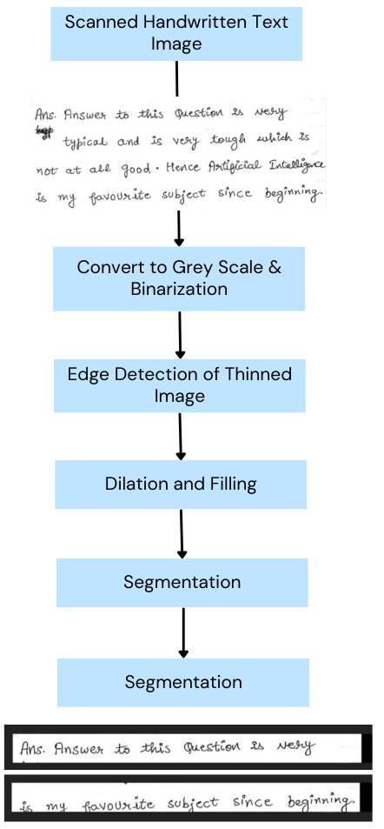
Proposed System
The proposed method use CTC loss for calculation and a combination of CNN, RCNN, RNN, and LSTM algorithms for training. The proposed system will have the following components:
Dataset:
A frequently used benchmark dataset for offline handwriting recognition is the IAM dataset. Its handwritten pages from several writers, all of varying writing styles, make it a difficult dataset to recognize. To extract specific words and their accompanying labels for training, the dataset is pre-processed.

Slide 12
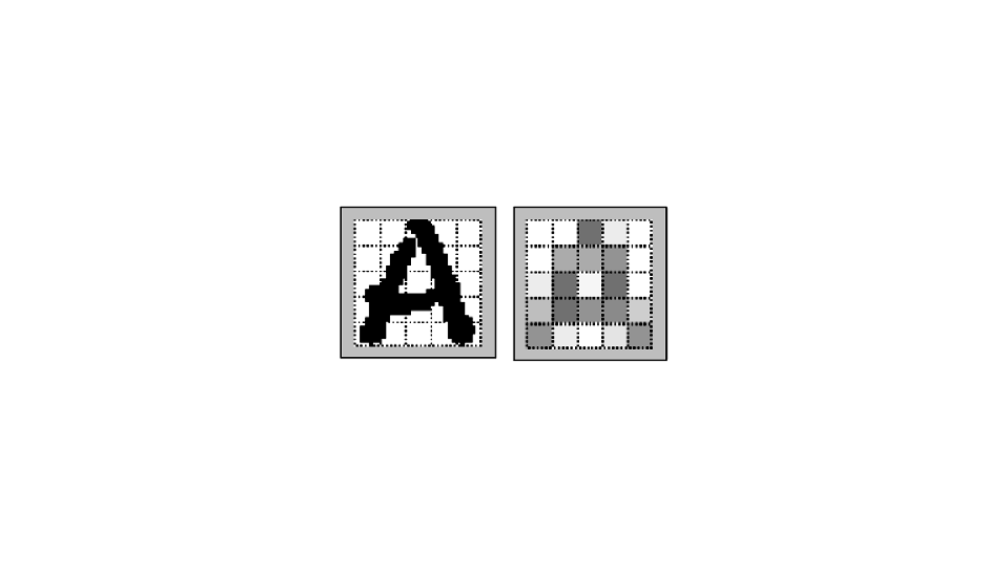
Proposed System
Data Pre-processing:
The handwritten word images in the IAM dataset have been pre-processed into a format that can be used to train neural networks.
The photos are then normalized to have a zero mean and unit variance after being initially resized to a fixed size. After that, the data is divided into training and testing sets.
Feature Extraction:
The CNN architecture is then fed the pre-processed photos to extract the important features from the image. The CNN layers have been trained to recognize the patterns and characteristics unique to handwriting.

Slide 13
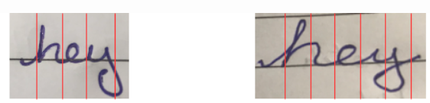
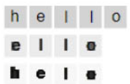
Proposed System
Region Proposal:
The RCNN algorithm is utilized to produce region recommendations for each image after the features have been retrieved. The handwritten text is most likely to be found in a set of candidate regions that are created by the region suggestion approach.
Sequence Labelling:
The RNN and LSTM architectures are then used to conduct sequence tagging on the output of the RCNN architecture. The purpose of the RNN and LSTM layers is to record the temporal relationships between the various regions and the characters that make up those areas.

Slide 14
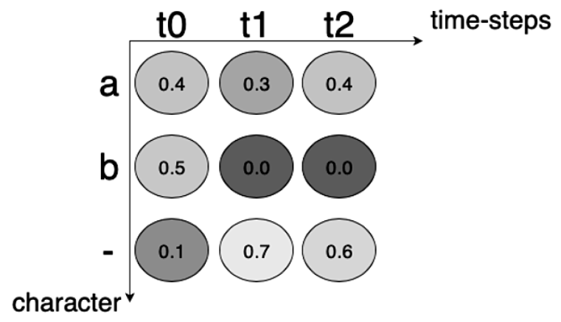
Proposed System
Loss Calculation:
The training loss is calculated using the CTC loss function. The neural network may understand the alignment between the input sequence and the output sequence without the requirement for explicit alignment due to the widely used loss function CTC in sequence labelling tasks.
Classification:
The final output layer is used to categories the order of characters in the handwritten text after the network has been trained. On the testing set, the system is assessed for accuracy and performance.

Slide 15
Modules

Slide 16
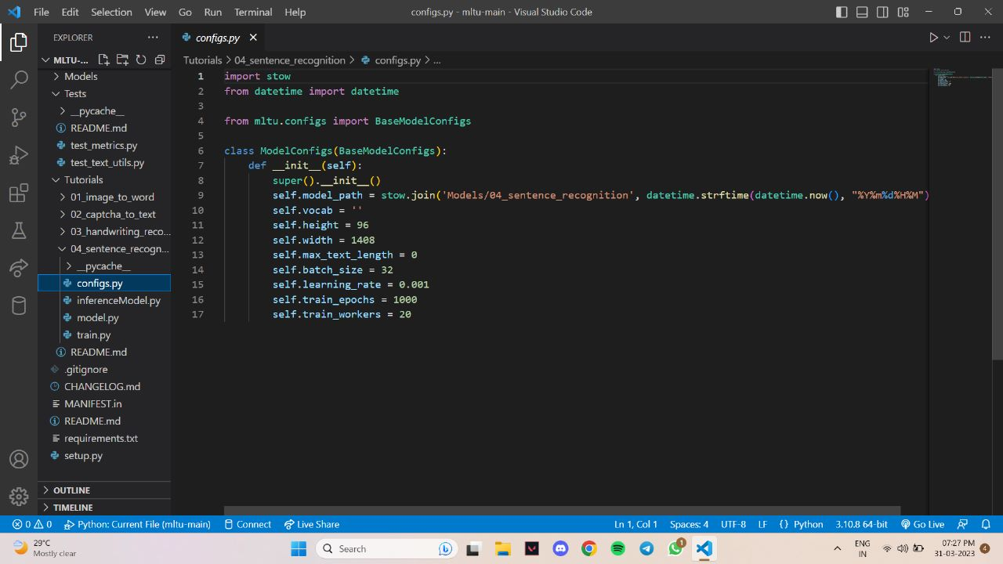
Model Configuration

Slide 17
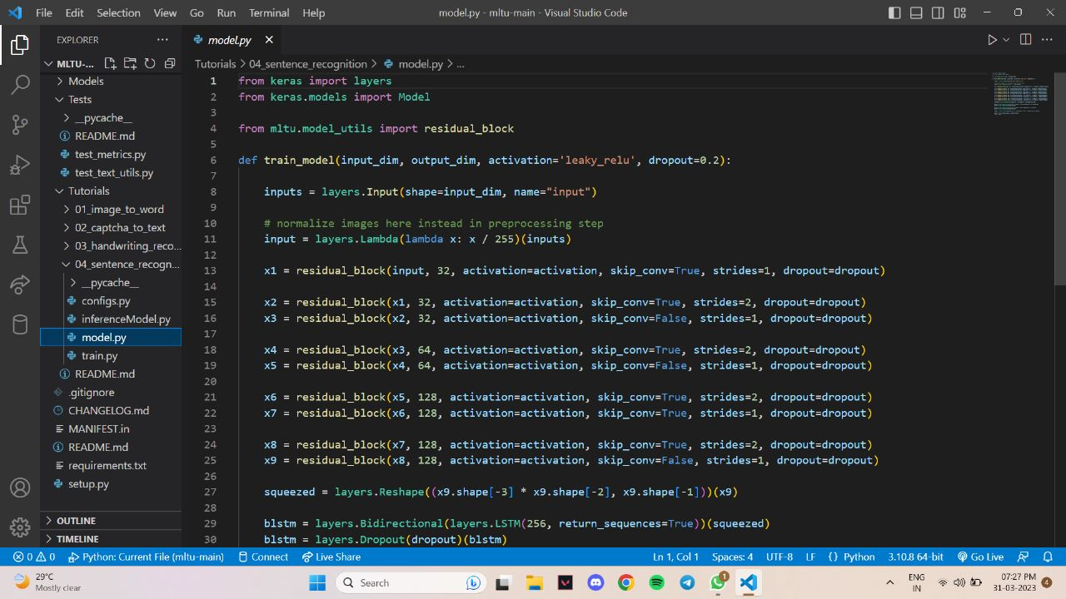
Model creation

Slide 18
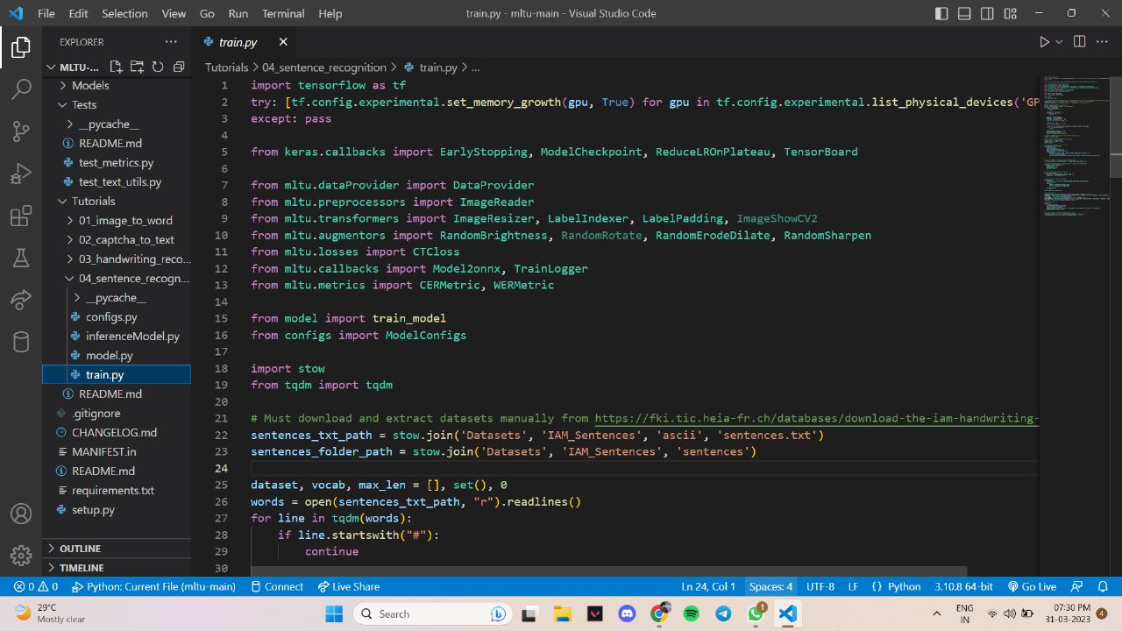
Training Model

Slide 19
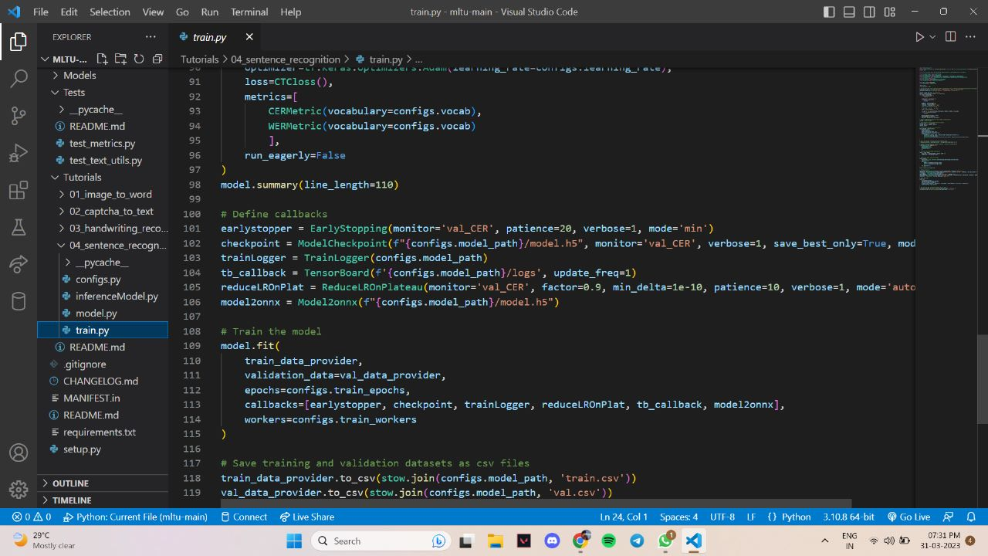

Slide 20
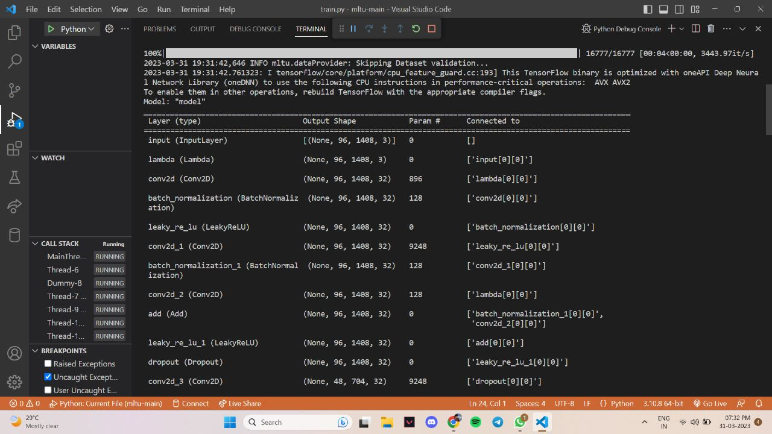
Output Screen of Training Model

Slide 21
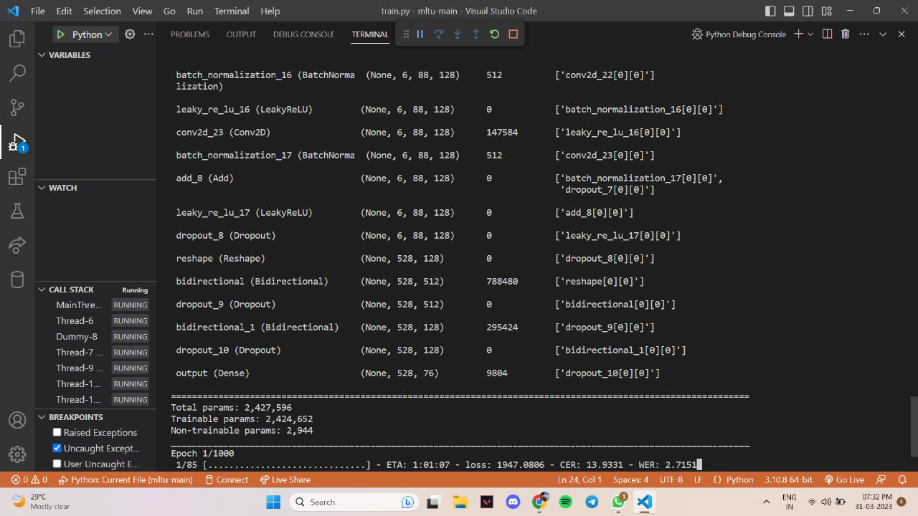

Slide 22
Conclusion
In conclusion, the suggested approach has many promising utility, including handwritten text input for mobile devices, signature verification, and digitising handwritten documents. The system is a viable approach for tackling the issues with offline handwriting recognition because of its high recognition accuracy and capacity to recognise various handwriting styles.

Slide 23
Reference
Nemmour, Hassiba, and Youcef Chibani. "Handwritten Arabic word recognition based on Ridgelet transform and support vector machines." High Performance Computing and Simulation (HPCS), 2011 International Conference on. IEEE, 2011.
Singh, Pritpal, and Sumit Budhiraja. "Offline handwritten gurmukhi numeral recognition using wavelet transforms." International Journal of Modern Education and Computer Science 4.8 (2012).
Rahiman, M. Abdul, et al. "Isolated handwritten Malayalam character recognition using HLH intensity patterns." Machine Learning and Computing (ICMLC), 2010 Second International Conference on. IEEE, 2010.
J. Hussain, Vanlalruata Department of Mathematics and Computer Science Mizoram University Aizawl, India
Graph-based Handwritten Digit String Recognition Alexander Filatov, Alexander Gitis, Igor Kil Offline Recognition Department Paragraph International 1309 S.Mary Ave., #150 Sunnyvale, CA 94087 USA

Slide 24
Reference
Handwritten Character Recognition using Neural Network and TensorFlow Year : 2019 Authors : Megha Agarwal, Shalika, Vinam Tomar, Priyanka Gupta
Improved Handwritten Digit Recognition Using Convolutional Neural Networks (CNN) Year : 2020 Authors: Savita Ahlawat , Amit Choudhary , Anand Nayyar , Saurabh Singh and Byungun Yoon
Handwritten Character Recognition Using Deep-Learning Rohan Vaidya1 , Darshan Trivedi1 , Sagar Satra1 1. EXTC Department Dwarkadas J Sanghvi College of Engineering, Mumbai, India Prof.
Mrunalini Pimpale2 2. EXTC Department Dwarkadas J Sanghvi College of Engineering, Mumbai, India
Handwritten Character Recognition Using Deep-Learning Rohan Vaidya1 , Darshan Trivedi1 , Sagar Satra1 1. EXTC Department Dwarkadas J Sanghvi College of Engineering, Mumbai, India Prof. Mrunalini Pimpale2 2. EXTC Department Dwarkadas J Sanghvi College of Engineering, Mumbai, India

Slide 25
Reference
Siham Tabik, Daniel Peralta, Andrs Herrera-Poyatos, Francisco Herrera. ”A snapshot of image Pre-Processing for convolutional neural networks: Case study of MNIST” in International Journal of Computational Intelligence Systems 10(1):555 January 2017
Agnihotri, Ved Prakash. "Offline Handwritten Devanagari Script Recognition." Information Technology and Computer Science
On the Benefits of Convolutional Neural Network Combinations in Offline Handwriting Recognition. Dewi Suryani, Patrick Doetsch and Hermann Ney. Human Language Technology and Pattern Recognition, Computer Science Department (2016)
A Novel Handwritten Digit Classification System Based on Convolutional Neural Network Approach Year: 2021 Authors: Ali Abdullah Yahya, Jieqing Tan, Min Hu

Slide 26
Thank You

